Slide 1



Car Diagnosis
Expert System
Under the Supervision of:
Dr. Mohamed Rehan

Slide 2


🛠 What Problem Are We Solving?
We present an expert system for diagnosing common car problems using Prolog. The system interacts with the user by asking a series of questions about observable car symptoms and provides possible diagnoses along with explanations.
It uses Prolog's logical inference capabilities to simulate expert reasoning.

Slide 3


🛠 Features
User-friendly questions in plain English.
Input validation with re-prompting.
Logical symptom skipping to reduce unnecessary questions.
Clean, grouped output with bullet points and system section headers.
Expandable architecture (easy to add new symptoms or diagnoses).

Slide 4
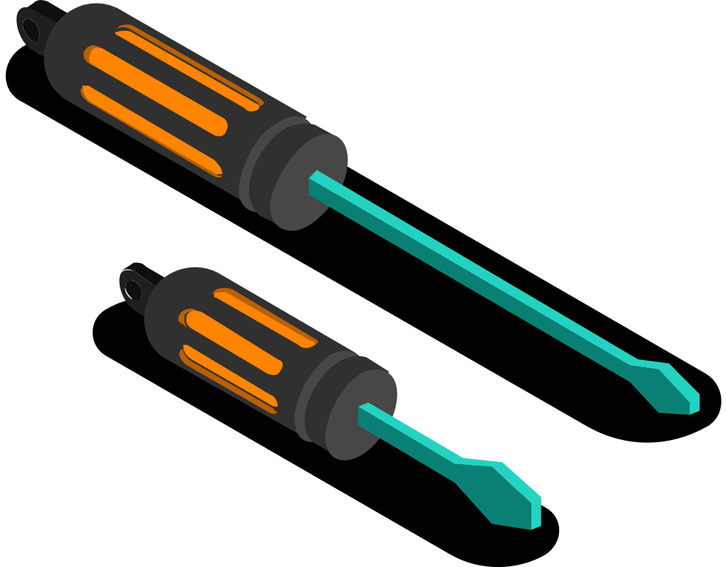
System Architecture
01
Symptom Collection
Asks the user questions based on known symptom descriptions.
Skips unnecessary questions using conditional logic.
02
Diagnosis Rules
The system uses IF-THEN rules.
Example: If ignition_on and engine_fails_to_crank, then the diagnosis is clean_and_tighten_battery_terminals.

Slide 5
System Architecture
03
Inference Engine
Uses backward chaining to infer conclusions.
Some diagnoses depend on others, creating a layered logic structure.
04
Explanation Module
Maps each diagnosis to a clear explanation for user understanding

Slide 6
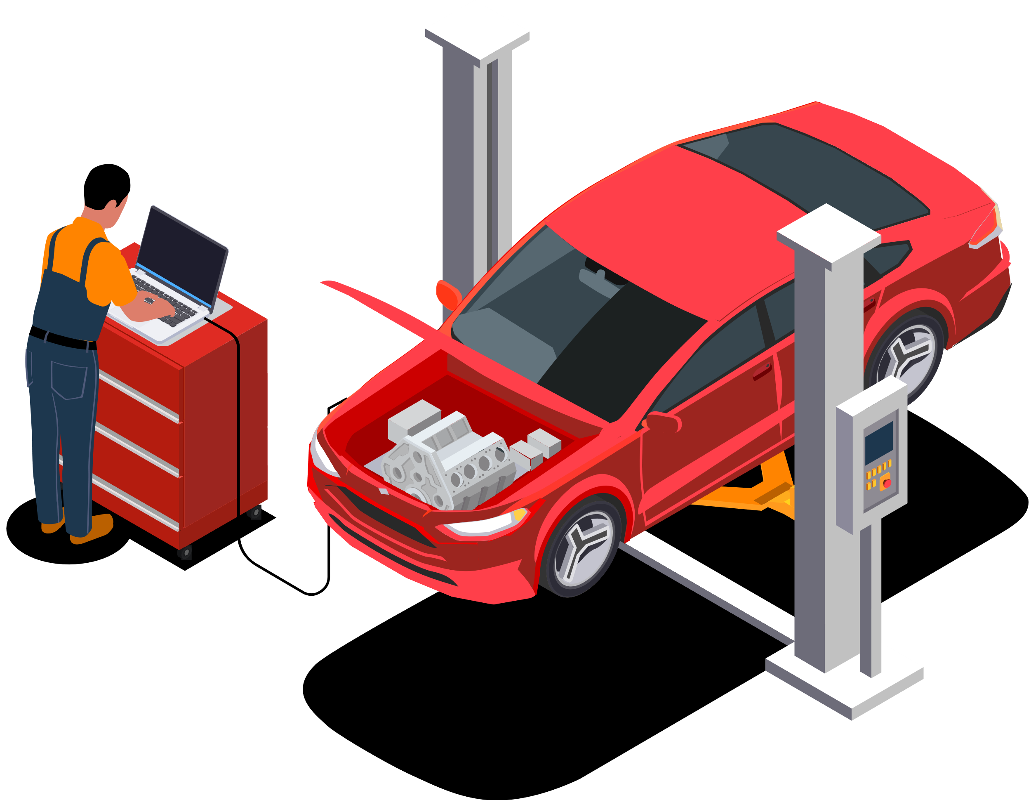
System Architecture
05
Categorization
For better clarity, groups are diagnosed by system area (e.g., electrical, cooling).

Slide 7
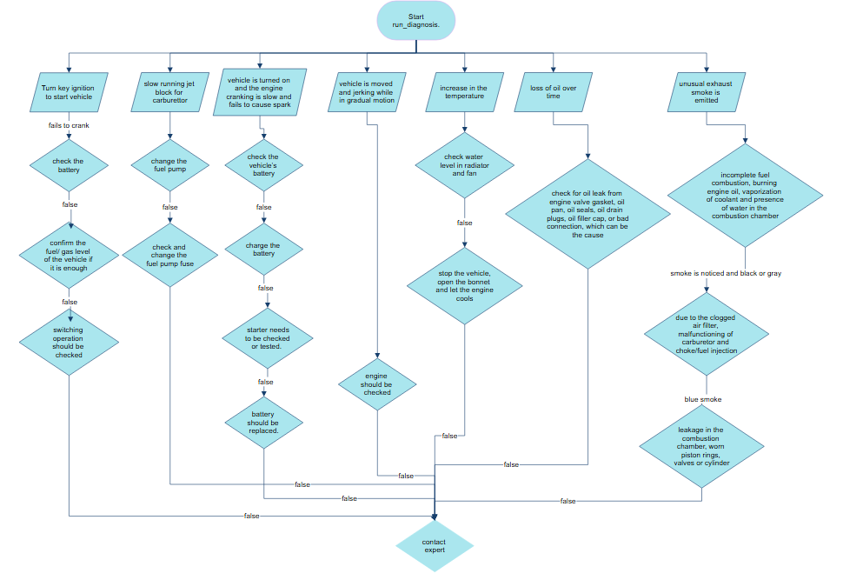

Slide 8


Prolog Code

Slide 9
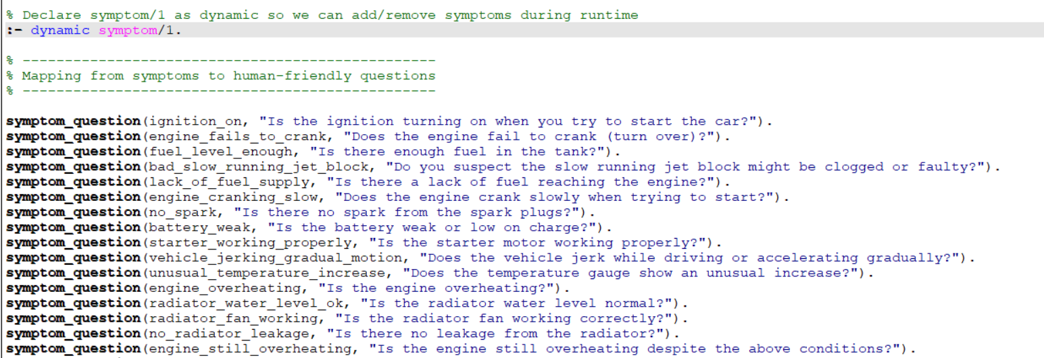
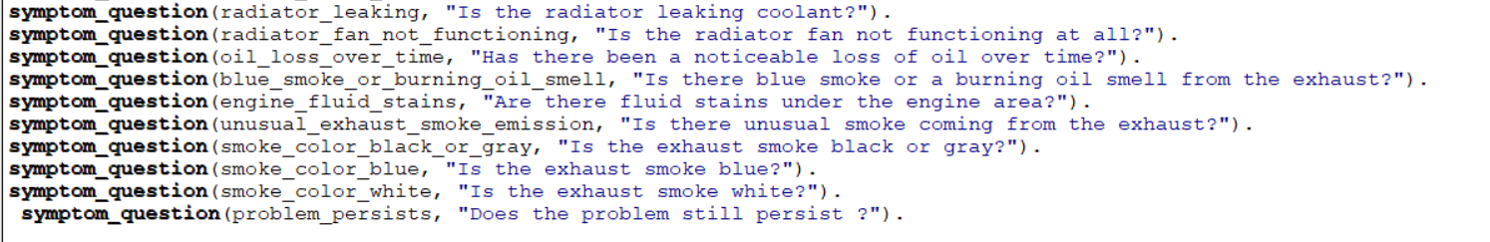

Slide 10
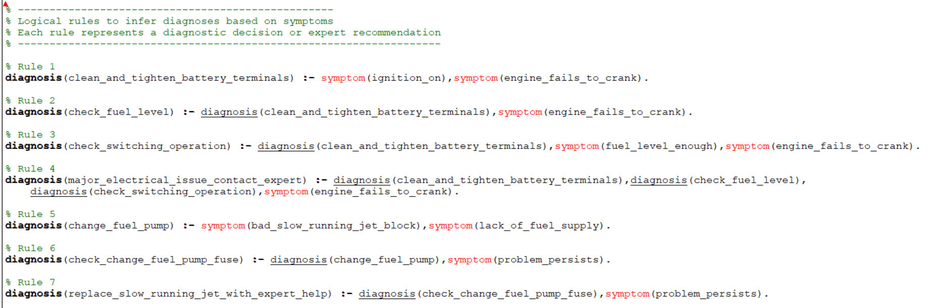
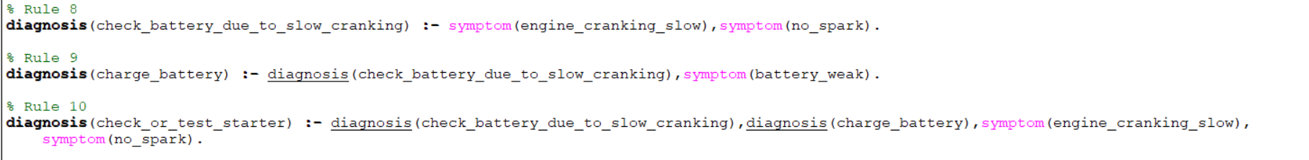

Slide 11
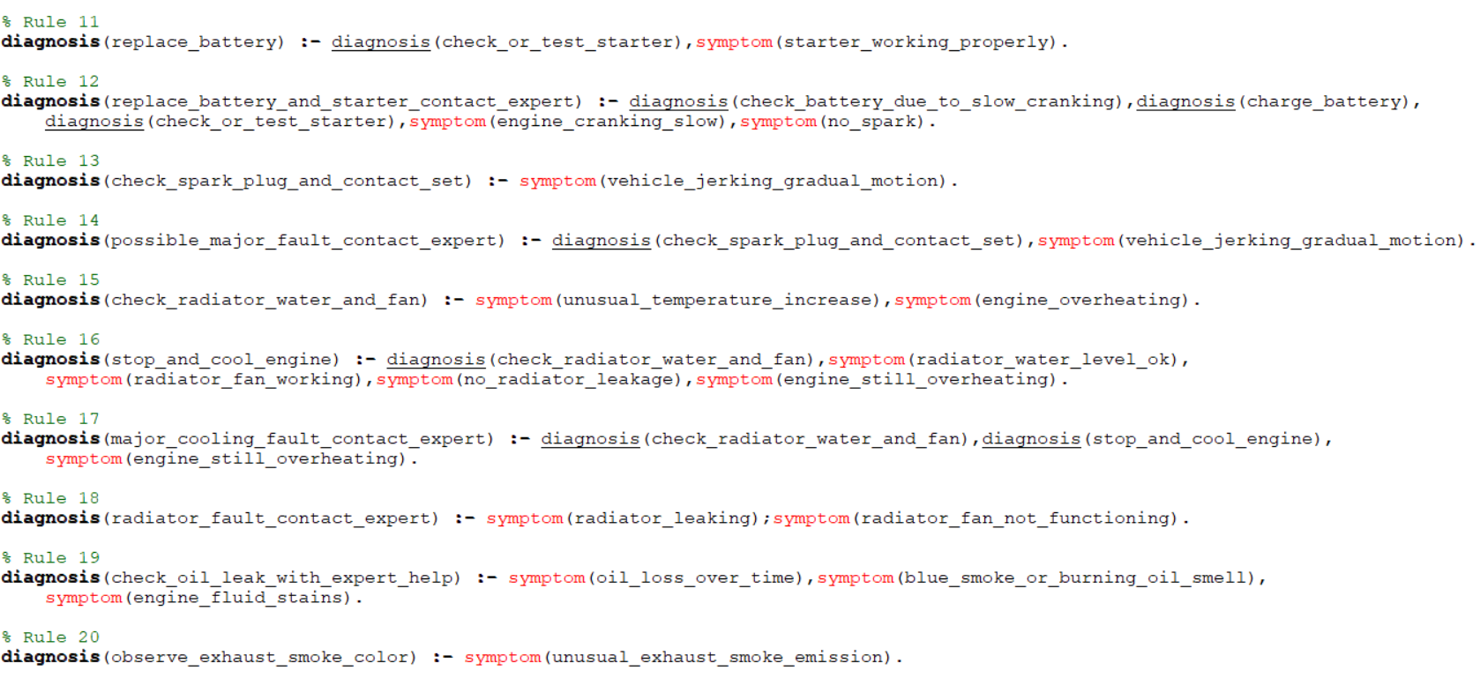
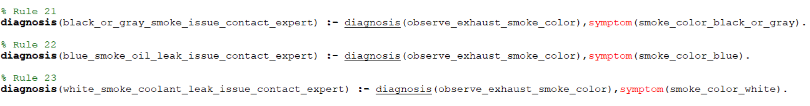

Slide 12
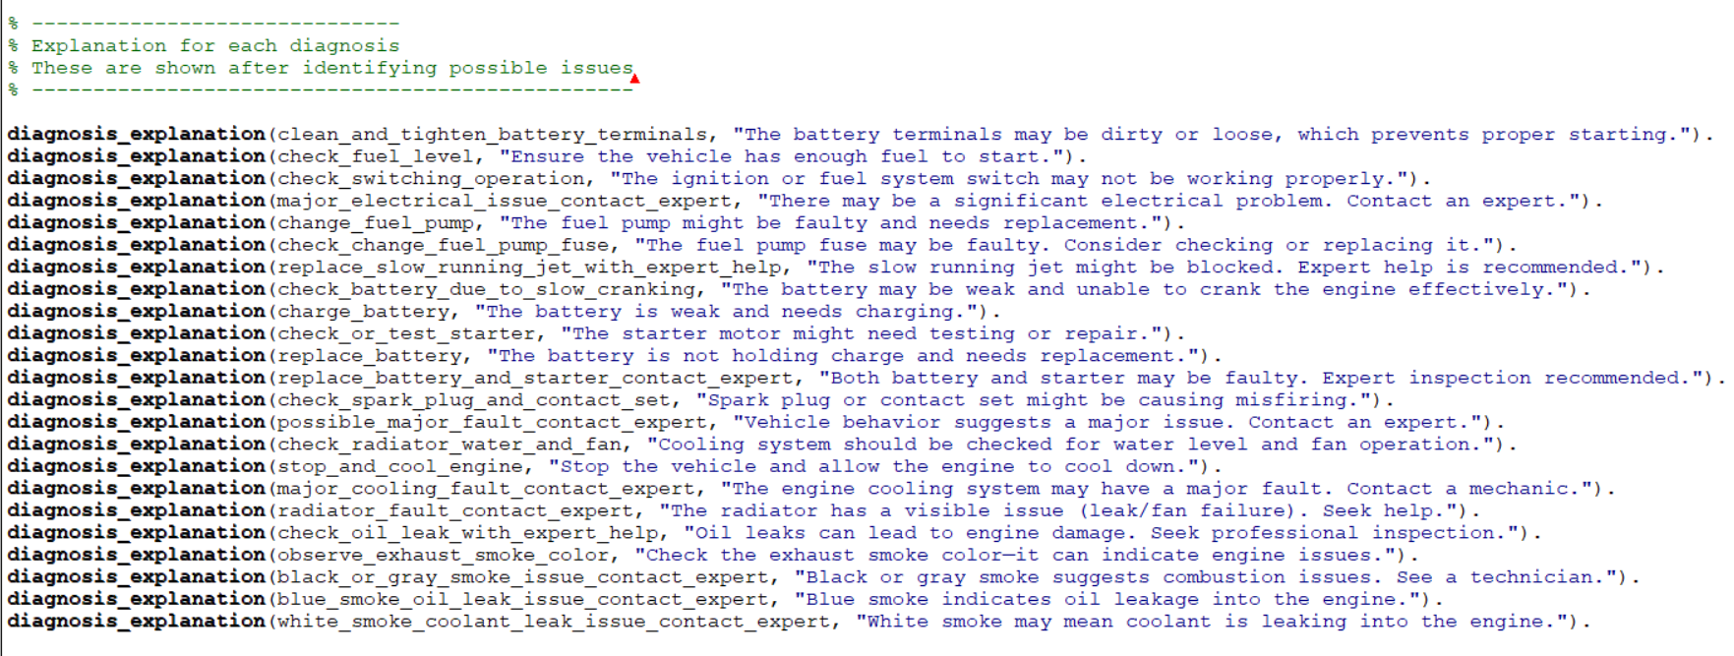

Slide 13
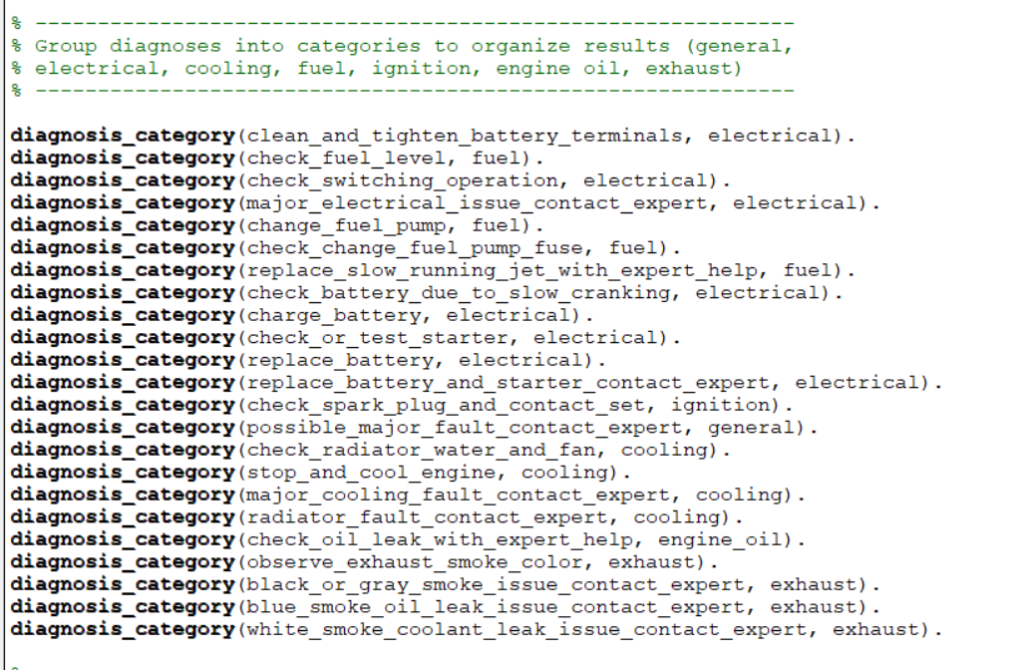

Slide 14
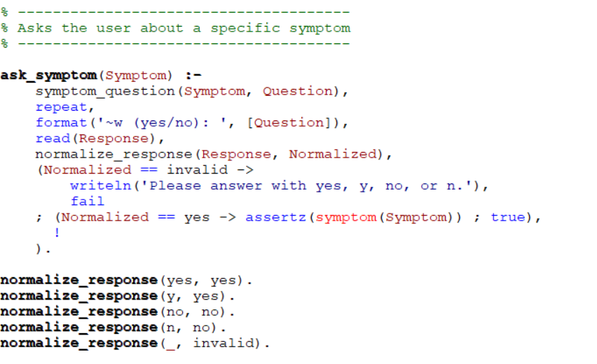
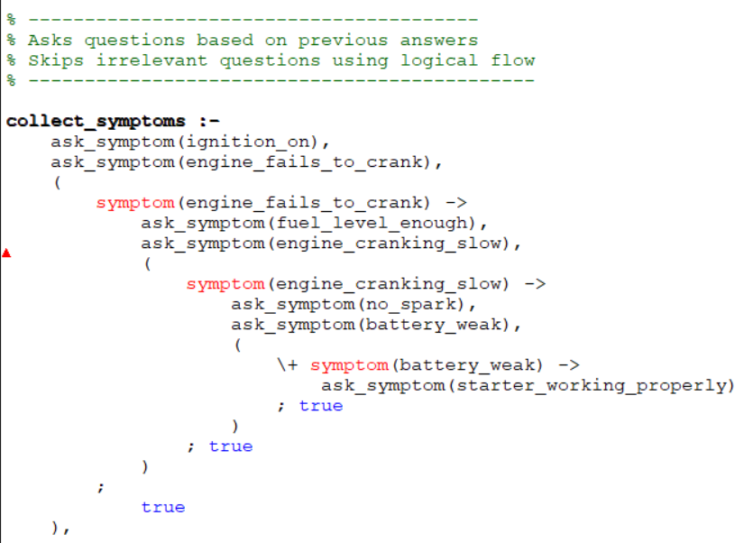

Slide 15
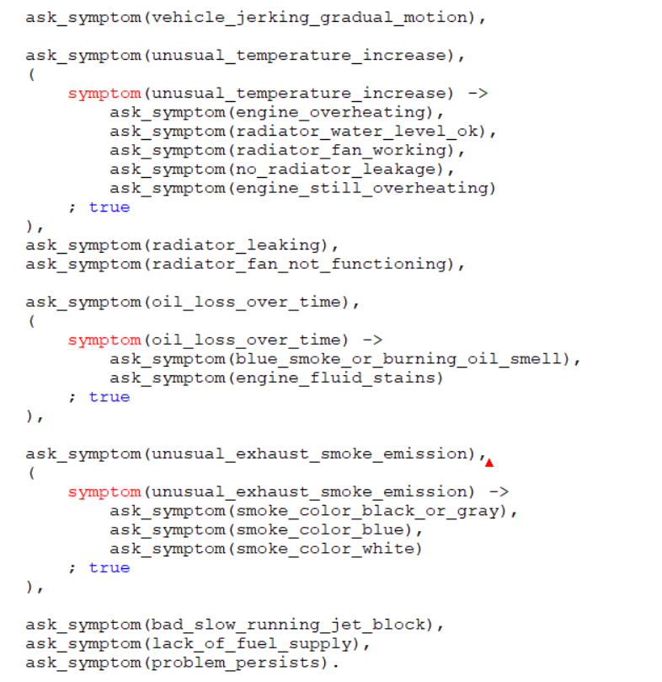

Slide 16
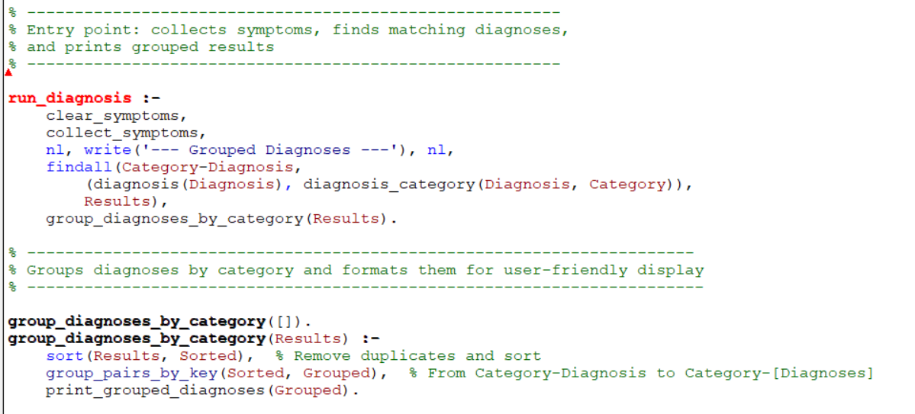

Slide 17
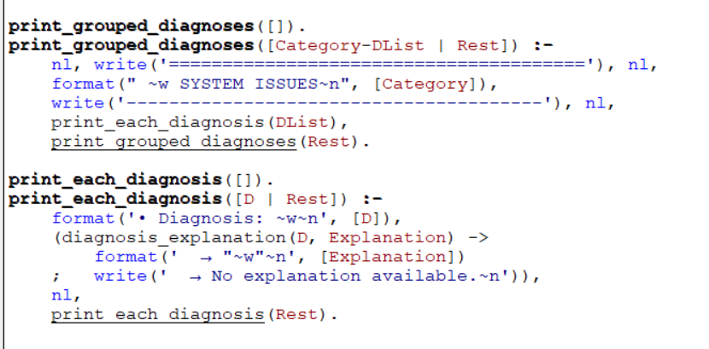

Slide 18
Sample Output

Slide 19
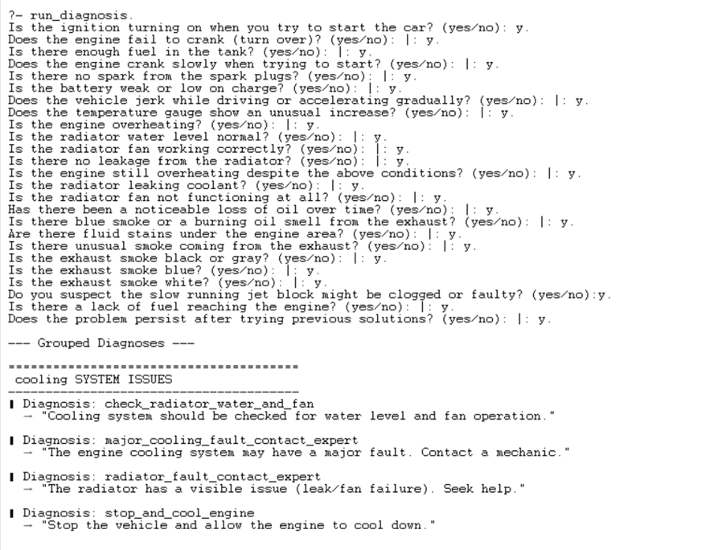

Slide 20
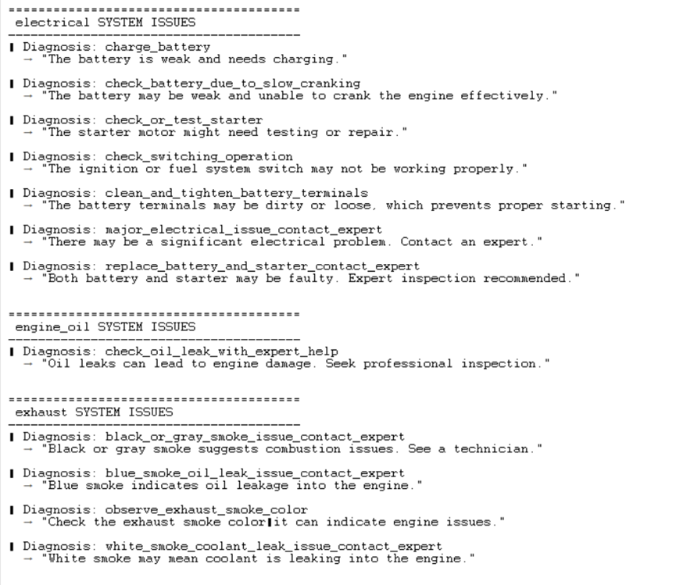

Slide 21
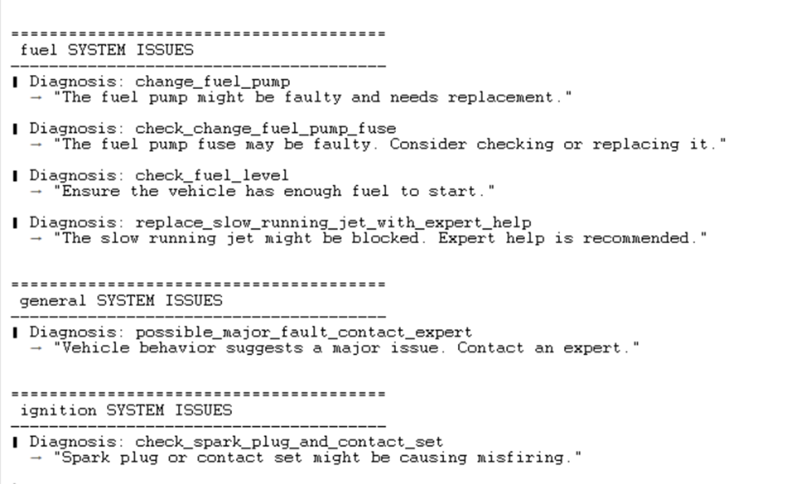

Slide 23
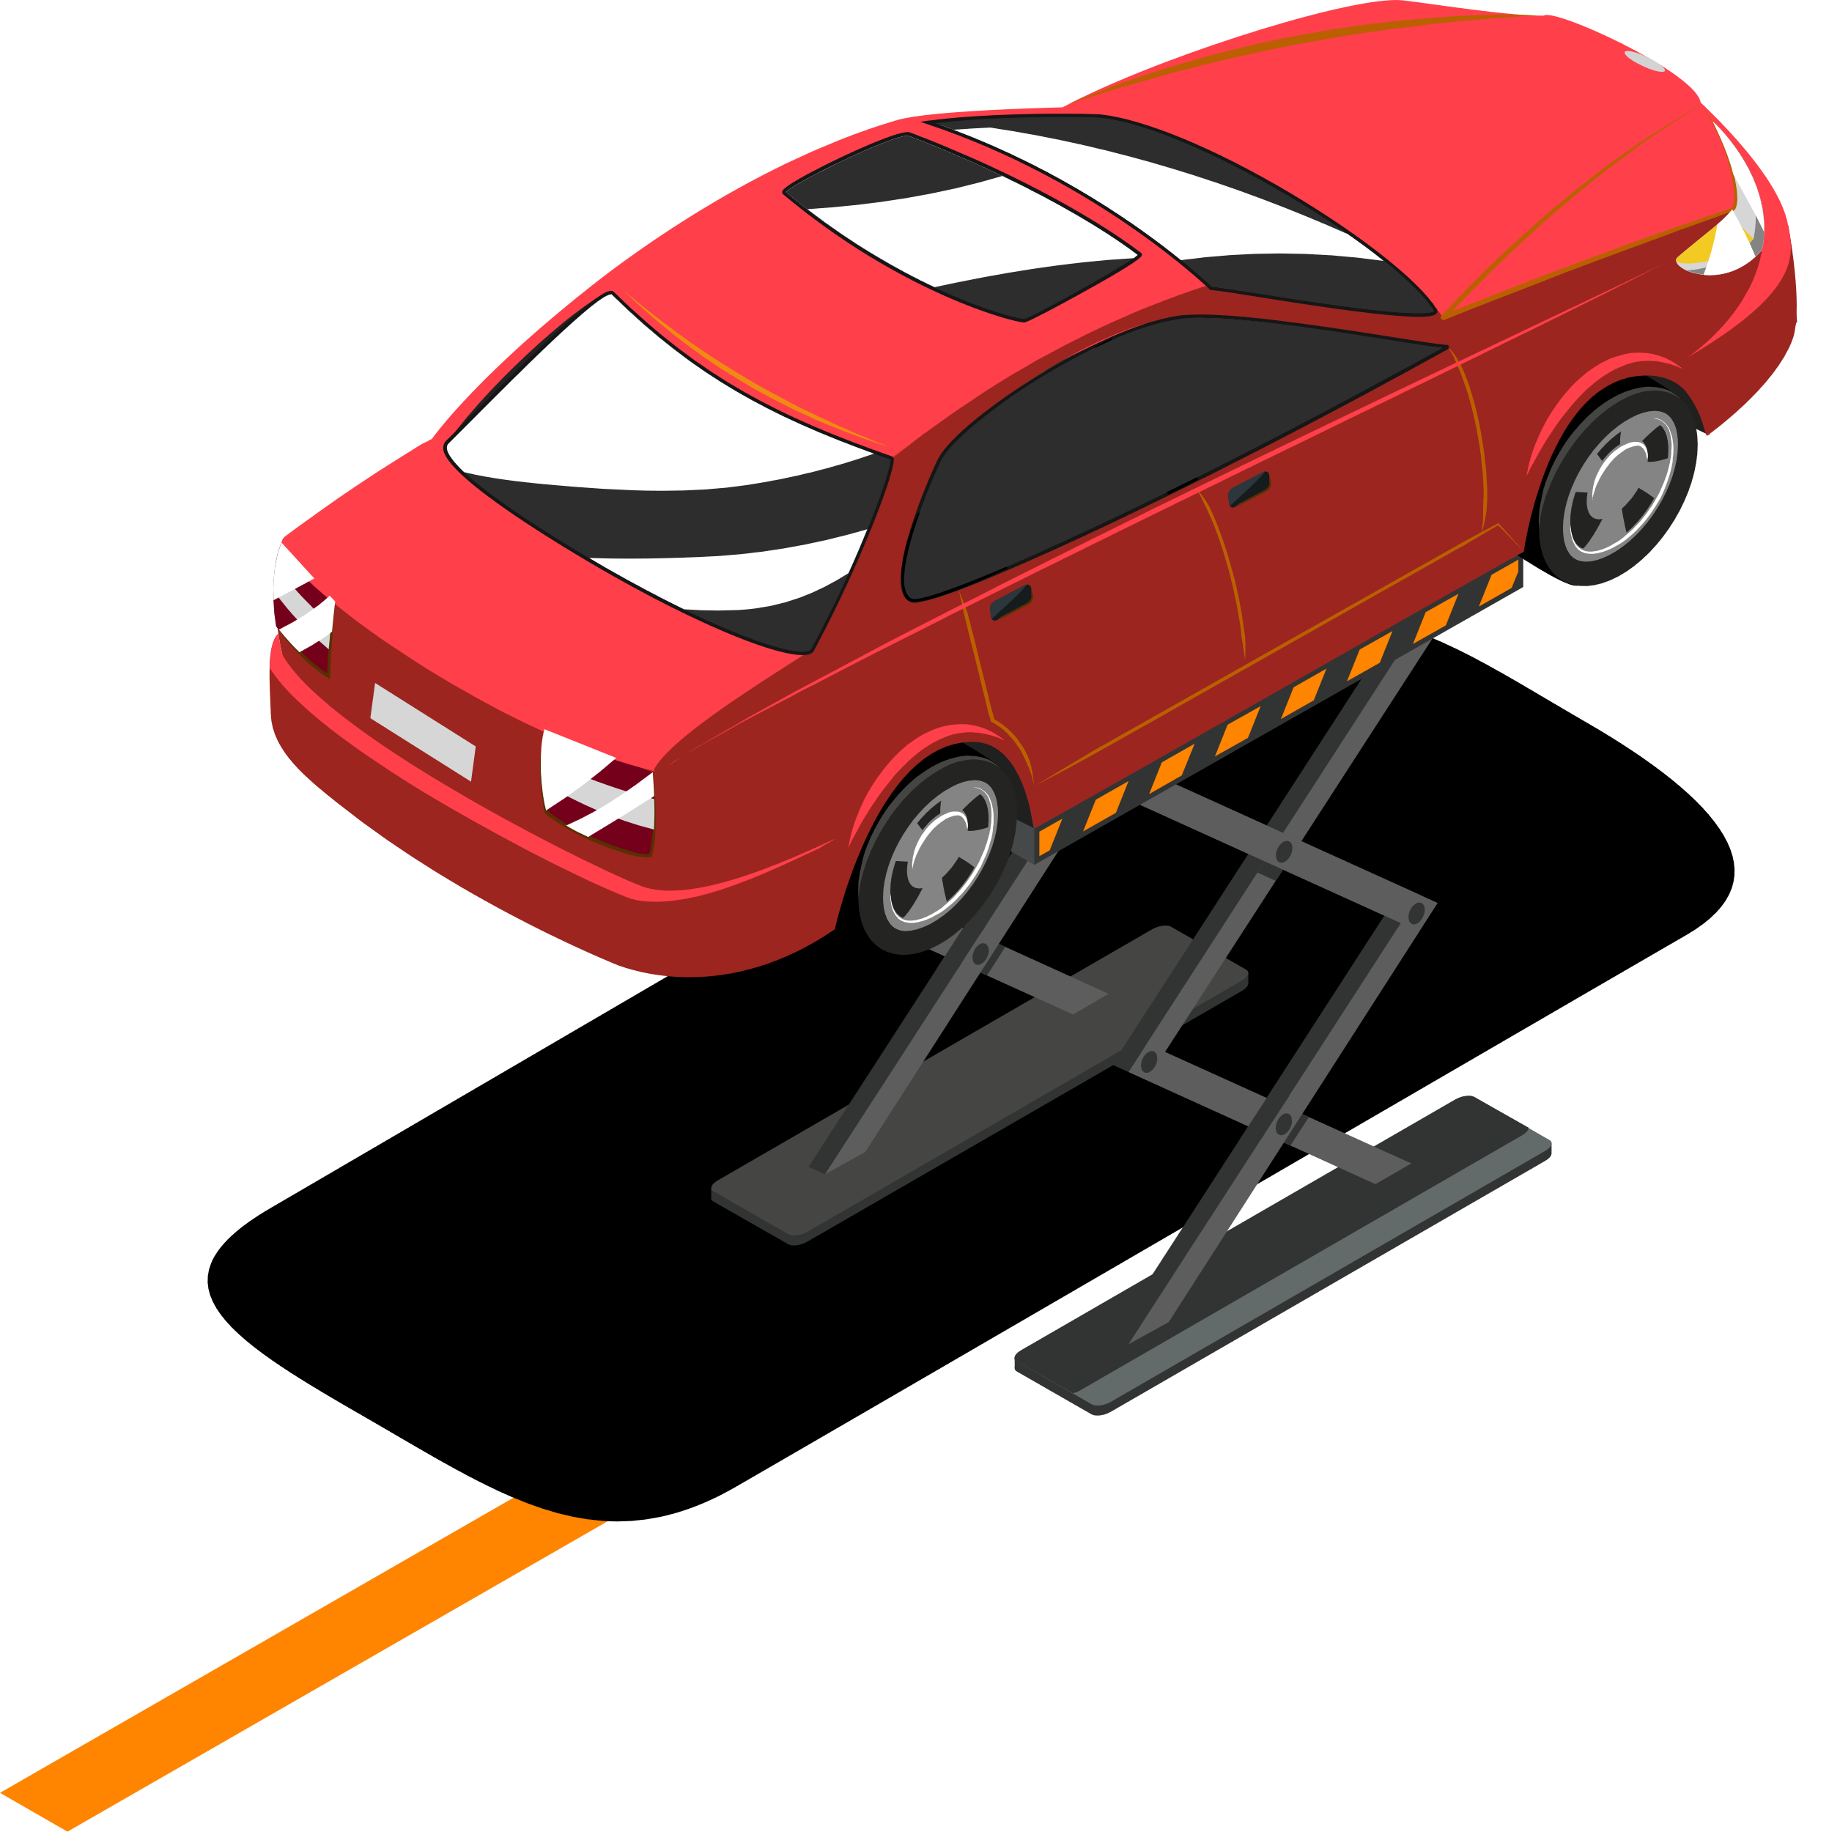



Thanks!
Any Questions?

